Slide 1
Python Error Handling
© Krishna Nimbalkar

Slide 2
What is Exception?
An exception is an event, which occurs during the execution of a program that disrupts the normal flow of the program's instructions. In general, when a Python script encounters a situation that it cannot cope with, it raises an exception. An exception is a Python object that represents an error.

Slide 3
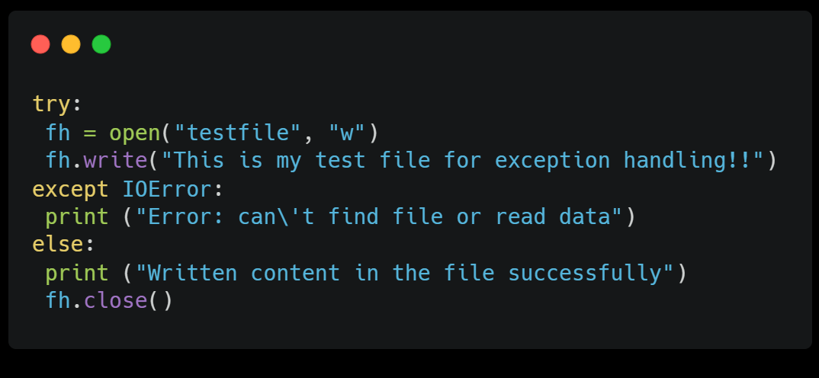
What is Exception?

Slide 4
EXCEPTION NAME | DESCRIPTION
Exception | Base class for all exceptions
StopIteration | Raised when the next() method of an iterator does not point to any object.
SystemExit | Raised by the sys.exit() function.
StandardError | Base class for all built-in exceptions except StopIteration and SystemExit.
ArithmeticError | Base class for all errors that occur for numeric calculation.
OverflowError | Raised when a calculation exceeds maximum limit for a numeric type.
FloatingPointError | Raised when a floating point calculation fails.
ZeroDivisonError | Raised when division or modulo by zero takes place for all numeric types.
AssertionError | Raised in case of failure of the Assert statement.
AttributeError | Raised in case of failure of attribute reference or assignment.
EOFError | Raised when there is no input from either the raw_input() or input() function and the end of file is reached.
ImportError | Raised when an import statement fails.
KeyboardInterrupt | Raised when the user interrupts program execution , usually by pressing Ctrl+c.
LookupError | Base class for all lookup errors.
IndexError | Raised when an index is not found in a sequence.
KeyError | Raised when the specified key is not found in the dictionary.
NameError | Raised when an identifier is not found in the local or global namespace.
UnboundLocalError | Raised when trying to access a local variable in a function or method but no value has been assigned to it.
EnvironmentError | Base class for all exceptions that occur outside the Python environment.
IOError | Raised when an input/ output operation fails , such as the print statement or the open() function when trying to open a file that does not exist.
OSError | Raised for operating system-related errors.
SyntaxError | Raised when there is an error in Python syntax.
IndentationErro | Raised when indentation is not specified properly.
SystemError | Raised when the interpreter finds an internal problem, but when this error is encountered the Python interpreter does not exit.
SystemExit | Raised when Python interpreter is quit by using the sys.exit() function. If not handled in the code, causes the interpreter to exit.
TypeError | Raised when an operation or function is attempted that is invalid for the specified data type.
ValueError | Raised when the built-in function for a data type has the valid type of arguments+ but the arguments have invalid values specified.
RuntimeError | Raised when a generated error does not fall into any category.
NotImplementedError | Raised when an abstract method that needs to be implemented in an inherited class is not actually implemented.

Slide 5
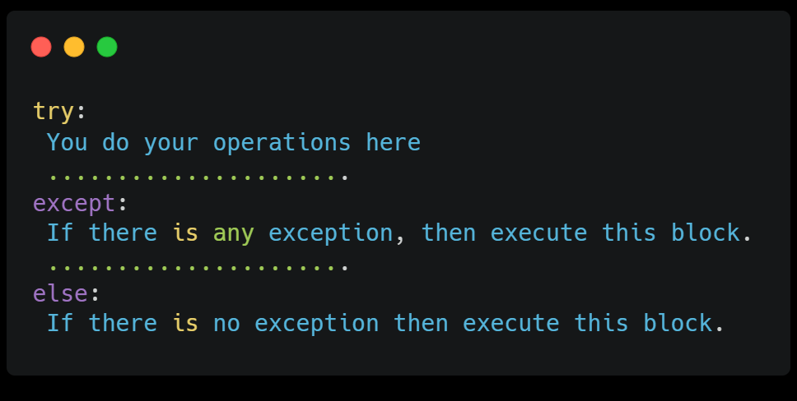
The except Clause with No Exceptions
You can also use the except statement with no exceptions defined as follows

Slide 6
THANKS
Do you have any questions?
kgn272000@gmail.com
+91 7020390678
Krishna Nimbalkar
Please keep this slide for attribution.

